Slide 1


UNIT 2: Time for action
Time for action

Slide 2
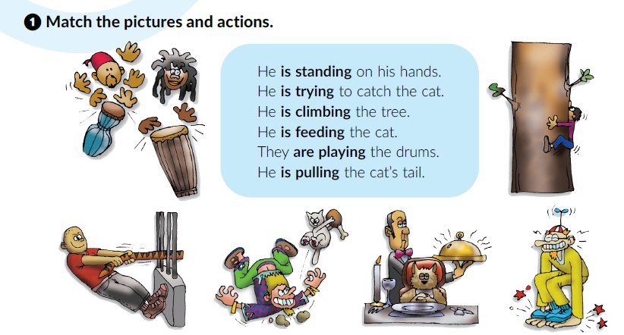
Open the PowerPoint presentation What are they doing?
Open your book at page 36.

Slide 3
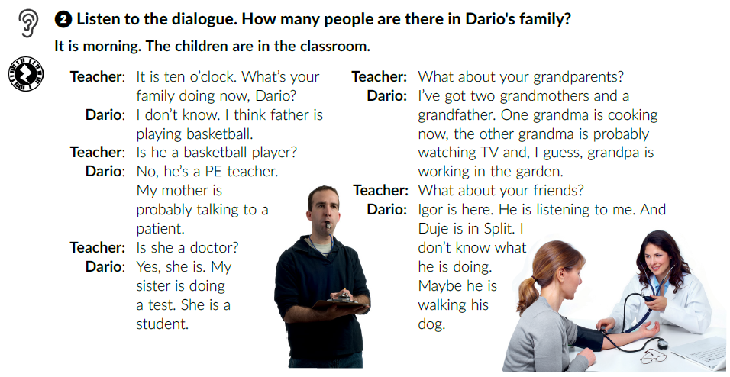

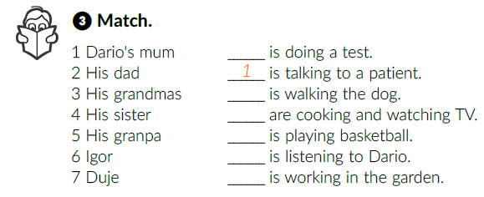
How many people are there in Dario’s family?
Six.
Listen again and match.
4
7
Read the dialogue out loud.
3
2
6
5

Slide 4
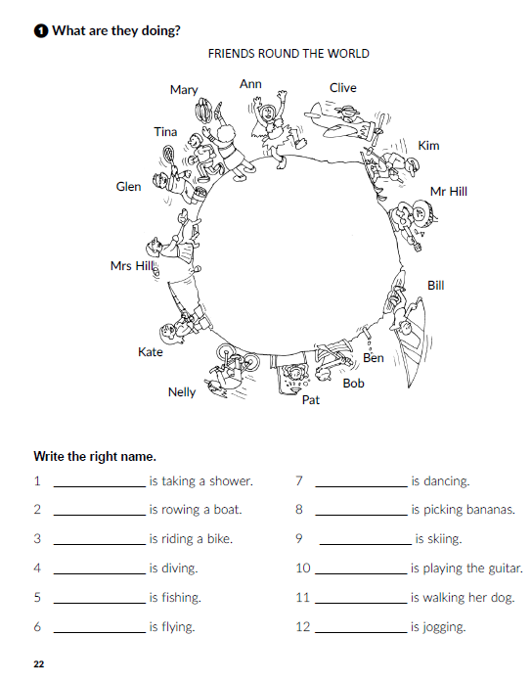
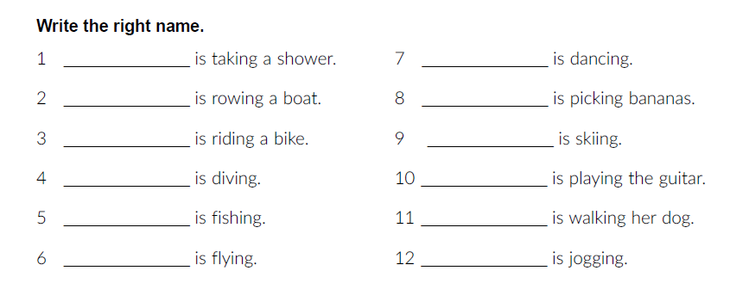
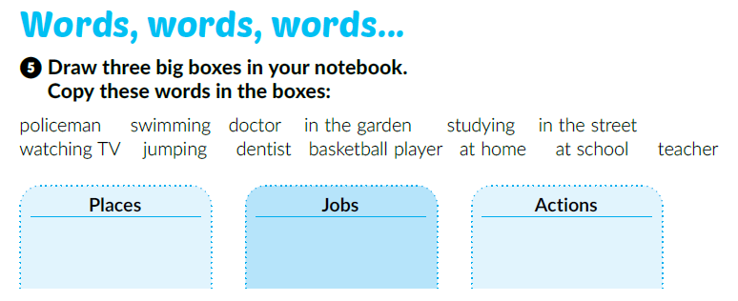
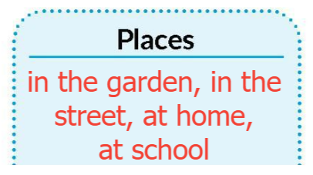
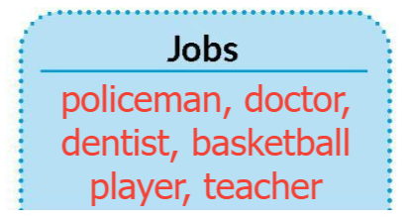
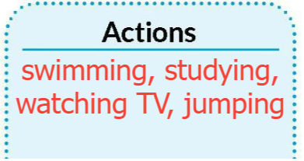

Sort out the words.
Open your workbook at page 22.
Pat
Ann
Bob
Mary
Nelly
Kim
Ben
Mr Hill
Kate
Mrs Hill
Clive
Tina
Click on the following link and choose Learn more: People in my home. Complete the tasks.
https://www.e-sfera.hr/dodatni-digitalni-sadrzaji/f58752c4-3343-4981-9d87-89952e72313c/

Slide 5
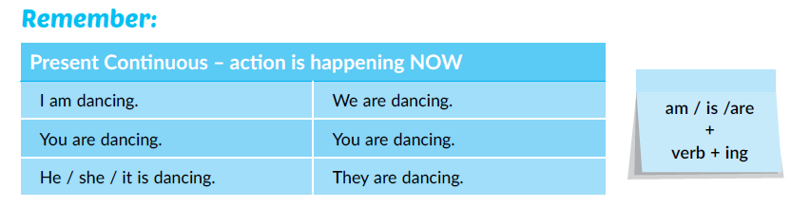
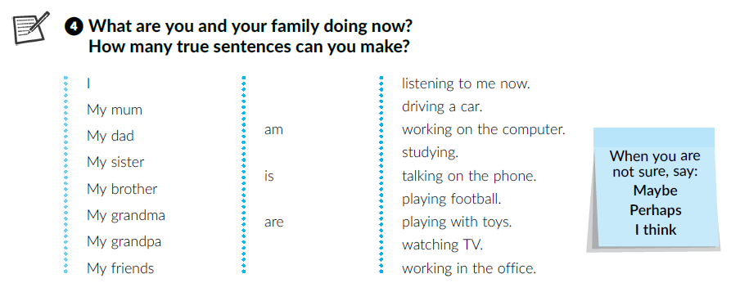
What are you doing now?
Write about your family.

Slide 6
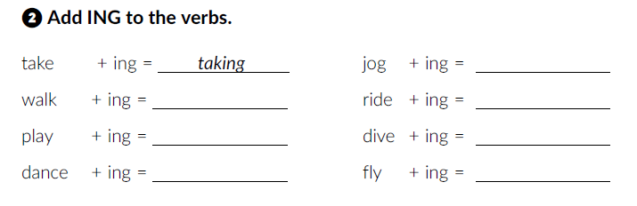
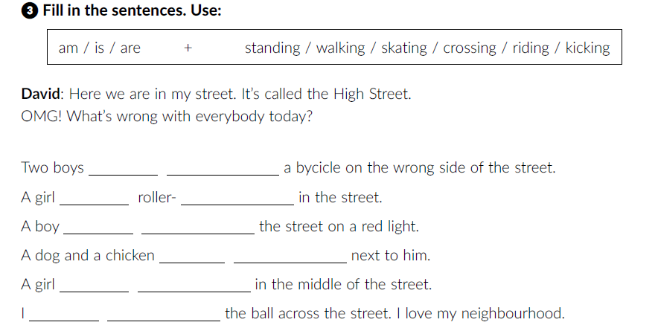
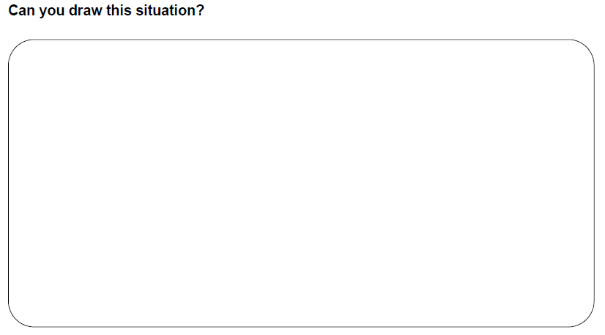
Workbook p. 23
jogging
walking
riding
playing
diving
dancing
flying
are riding
is skating
is crossing
are walking
is standing
am kicking

Slide 7
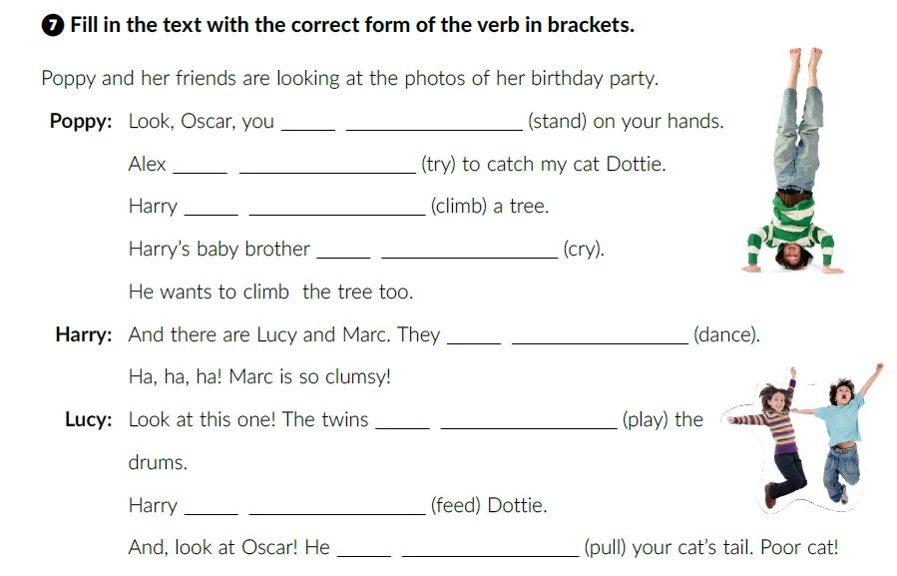
Workbook, p. 25
are standing
is trying
is climbing
is crying
are dancing
are playing
is feeding
is pulling

Slide 8
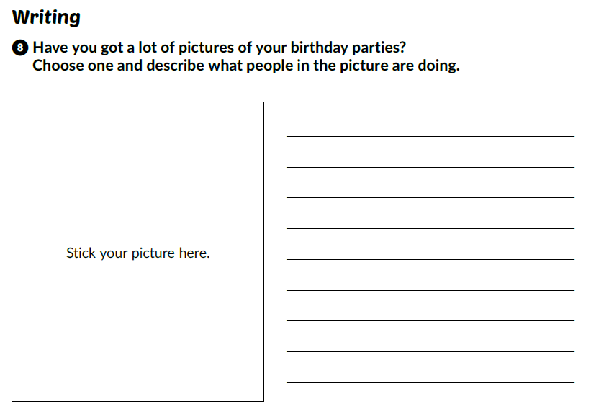
Use the Present Continuous tense.

Slide 9
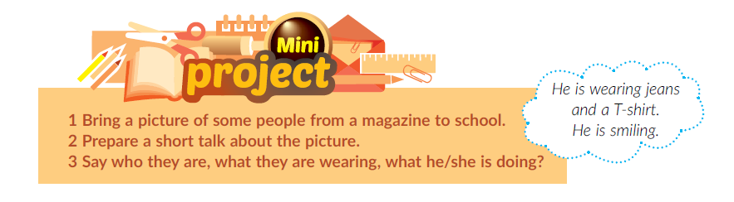
Click on the following link and choose Learn more: A garden birthday party. Complete the tasks.
https://www.e-sfera.hr/dodatni-digitalni-sadrzaji/f58752c4-3343-4981-9d87-89952e72313c/
Book, p. 39

Slide 10
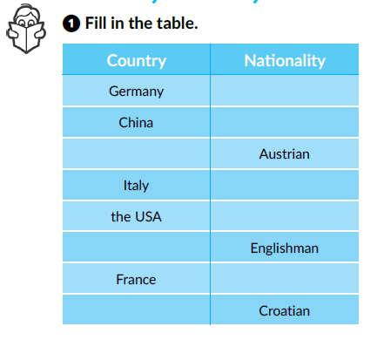
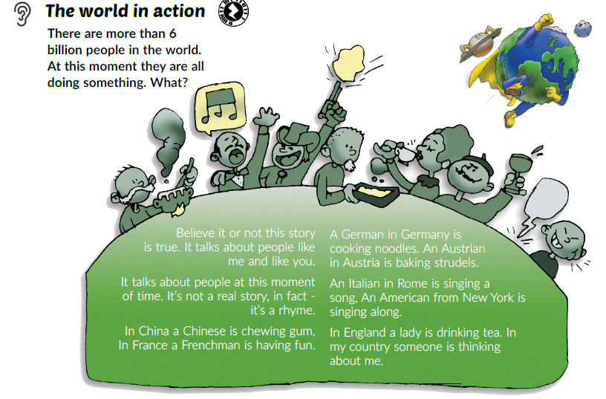
How many countries can you name in English?
Are their names different than in Croatian?
How do you call people who live in these countries?
Book, page 38.
Listen and fill in the chart.
German
Chinese
Austria
Italian
American
England
Frenchman
Croatia

Slide 11
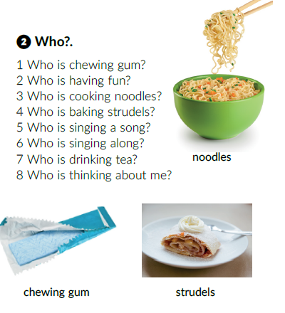
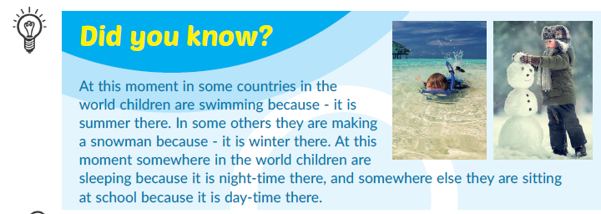
Listen again and answer the questions.

Slide 12
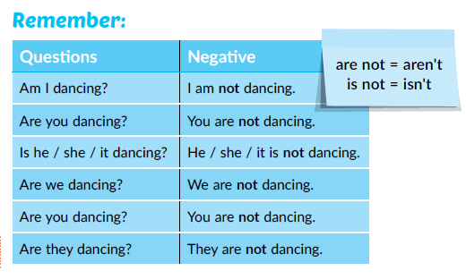
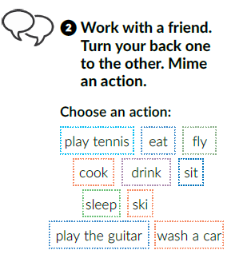
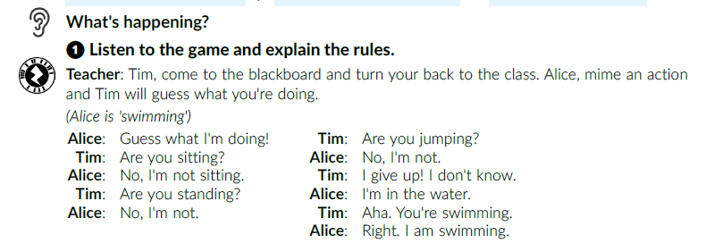
Look at the Remember box. How do we make questions and negative sentences?

Slide 13
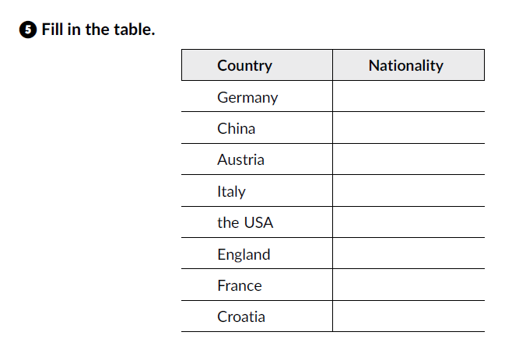
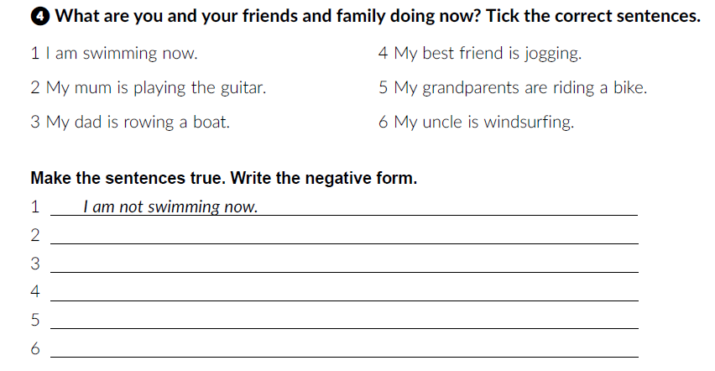
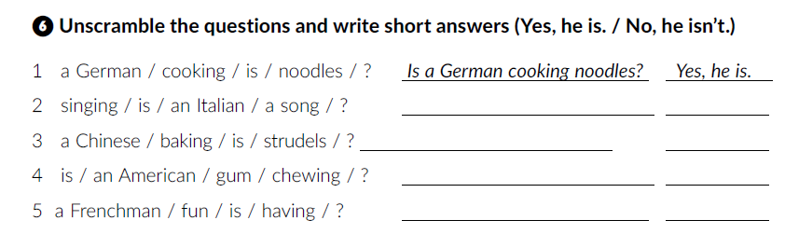
Open your workbook at page 24.
German
Chinese
Austrian
Italian
American
Englishman
Frenchman
Croatian
Is an Italian singing a song? Yes, he is.
Is a Chinese baking strudels? No, he isn’t.
Is an American chewing gum? Yes, he is.
Is a Frenchman having fun? Yes, he is.

Slide 14
Self check.
https://www.e-sfera.hr/dodatni-digitalni-sadrzaji/f58752c4-3343-4981-9d87-89952e72313c/

